Slide 1
Epilepsy

Slide 2
Is it a fit / seizure?
Is it epilepsy?

Slide 3
Paroxysmal events
Seizures
Non-seizure
events
syncope
pseudo-seizures
migraine
TIA
.....
Epilepsy
Acute symptomatic
seizures

Slide 4
Is it a seizure?
transient occurrence of signs and/or
symptoms due to abnormal excessive or synchronous neuronal activity in the brain
brief disturbance in consciousness, behaviour, emotion, motor function or sensation

Slide 5
Is it epilepsy?
tendency to recurrent seizures

Slide 6
Acute symptomatic seizures
Provoked seizures -
  associated with acute encephalopathic state -
alcohol, drugs, metabolic, infection, trauma, vascular, etc.
confusion / systemic disturbance lasting more than seizure
seizures stop when acute encephalopathic state is resolved

Slide 7
Paroxysmal events
Seizures
Non-seizure
events
Epilepsy
syncope
pseudo-seizures
migraine
TIA
metabolic
sleep phenomena .....
Acute symptomatic
seizures

Slide 8
 | seizure | syncope

Slide 9
 | seizure | syncope
precipitant | usually none | usually +
situation | any, sleep attacks + | upright, emotion
onset | rapid, aura +/- | gradual , ‘feel faint’, dizzy, blurred vision
motor | rigid, tonic/clonic | flaccid, ? jerking
skin | pale/flushed, ?blue | pale
breathing | foamy, stertorous | shallow
HR, BP | ↑ | ↓
LOC | minutes | seconds
accompaniments | incontinence, injury | ? incontinent,
post ictal | prominent | -

Slide 10
 | seizure | pseudo-seizure
precipitant | usually none | usually +
situation | any, sleep attacks + | emotion, ‘audience’, inducible
onset | rapid, aura +/- | variable
motor | rigid, tonic/clonic | variable, bizarre - limb thrashing, tremor, posturing
duration | minutes | prolonged
accompaniments | incontinence, injury, side of tongue | incontinence, injury mild, tip of tongue
post ictal | prominent | vague, behavioural
associations | +/- | psycho-somatic, history of abuse

Slide 11
What is epilepsy?
tendency to recurrent seizures

Slide 12
What is Epilepsy?
tendency to recurrent seizures
two unprovoked or reflex seizures occurring at least 24 h apart
at least one unprovoked or reflex seizure, with high risk of recurrence
diagnosis of epilepsy syndrome

Slide 13
Classification of Epilepsy

Slide 14
Classification of Epilepsy
generalized
partial
unclassifiable

Slide 15
Classification of Epilepsy
absence (petit mal)
tonic
clonic
tonic - clonic (grand mal)
myoclonic
atonic
generalized
partial
unclassifiable

Slide 16
Classification of Epilepsy
simple partial
complex partial
partial → IIry generalization
generalized
partial (focal)
unclassifiable

Slide 17
Diagnosis of Epilepsy

Slide 18
Diagnosis of Epilepsy
on clinical features - mainly history
eye witness account
investigations

Slide 19
evolution of a seizure

Slide 20
evolution of a seizure
prodrome - hours - hunger, irritability, lethargy, euphoria,…
aura - ~ 30 sec - focal onset
ictus - tonic - cry, extensor posturing, apnoea, fall, injury, incontinence
clonic - 1-2 min - limb jerks
post ictal changes - flaccid, confusion, drowsy, headache, body aches, violence, focal deficits (Todd paralysis)

Slide 21
How do I investigate?

Slide 22
How do I investigate?
EEG - ictal interictal
Imaging - CT MRI, functional MRI SPECT, PET

Slide 23
EEG in epilepsy
diagnostic aid
- 10-15% ‘normal’ population - abnormal EEG only 1% - spike-wave
- single inter ictal EEG - only 30% +ve repeated recording - ~ 50%
classify epilepsy - seizure type
detect underlying abnormality

Slide 24
Imaging in epilepsy - when?
late onset generalized seizures - > 20 years
partial seizures (focal onset)
focal neurological signs
focal EEG change
poor seizure control

Slide 25
Epilepsy syndromes

Slide 26
Idiopathic generalised epilepsy
seizure type - generalised tonic- clonic seizure (grand mal)
prodrome
no aura
ictus - tonic - cry, extensor posturing, apnoea, fall, injury, incontinence
clonic - 1-2 min - limb jerks
post ictal changes

Slide 27
Childhood absence epilepsy
seizure type - typical absence seizure (petit mal)
no prodrome, no aura
ictus - ‘absence’ - altered awareness
cessation of activity
motor changes - minimal
no post ictal changes

Slide 28
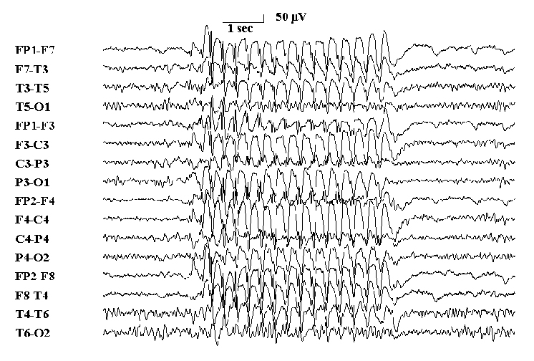
childhood absence epilepsy (petit mal)
generalized 3Hz spike-wave activity (can get in any primary gen. epilepsy)
abrupt onset and offset

Slide 29
Juvenile myoclonic epilepsy
seizure type - myoclonic, GTCS
myoclonic jerks - sleep deprivation, alcohol
prodrome -
no aura
ictus - myoclonic, GTCS
post ictal changes

Slide 30
Temporal lobe epilepsy
seizure type - complex partial seizure
aura - epigastric, olfactory, gustatory, speech, fear, memory - déjà vu, jamais vu, visual, …
absence (altered consciousness)
automatisms - oro-facial, motor, verbal, …
autonomic changes
post ictal changes
hippocampal sclerosis (MRI)
febrile convulsions, family history

Slide 31
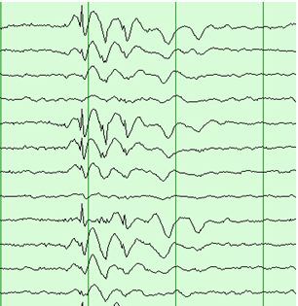
partial seizure
focal spike and wave discharges

Slide 32
Treating epilepsy

Slide 33
Life style change
avoid precipitants
sleep deprivation
hunger
fatigue
menstruation
alcohol
reflex epilepsy- visual stimuli, .....
….

Slide 34
Anti-epileptic drugs - AEDs

Slide 35
Anti-epileptic drugs - AEDs
Standard | New
carbamazepine | lamotrigine
phenytoin | vigabatrin
valproate | gabapentin
phenobarbitone | topiramate
clobazam | oxcarbazepine
clonazepam | levetiracetam

Slide 36
 | Narrow spectrum carbamazepine phenytoin oxcarbazepine gabapentin | Broad spectrum valproate lamotrigine topiramate levetiracetam
partial | √ | √
Iry generalized- GTCS | ?? | √
tonic / atonic |  | √
myoclonic | × | √ (not lamotrigine)
absence | × | √

Slide 37
 | DOC | 2nd line
partial | CBZ, ?VPA, ?PHE | lamot, new AED, clob
GTCS | VPA, CBZ | PHE
myoclonic | VPA | levetiracetam
other Iry gen. | VPA | lamotrigine levetiracetam topiramate
absences | VPA | ethosuximide
unclassified | < 25 years - VPA > 25 years - CBZ
infantile spasms | vigabatrin | ACTH

Slide 38
AEDs - when to start?
2 or more unprovoked seizures interval < 1 year
consider - wishes of patient / family
first fit - ?

Slide 39
AEDs - how to start?
monotherapy - 70% effective
rational polytherapy - 10% more
start with monotherapy
poor control - consider why? re-evaluate drug, dose, diagnosis
then consider polytherapy

Slide 40
AEDs - how to stop?
2-3 year seizure free interval
consider - wishes of patient / family
slow reduction - over 3-6 months

Slide 41
Epilepsy and pregnancy

Slide 42
Epilepsy and pregnancy - effects on foetus
satisfactory outcome in > 90%
↑ in birth defects - - 2-3 times more in mothers with epilepsy on AEDs > non epileptics
- risk ↑ with polytherapy
- which drug ? - VPA > PHT > CBZ
enzyme induction → vit K deficiency → fetal ICH

Slide 43
Epilepsy and pregnancy - management
ideally pre planned - withdraw AEDs 6 months before conception
folate supplementation
monotherapy
best drug for seizure type / syndrome
do not reduce / stop treatment
Vit K - last month of pregnancy, neonate

Slide 44
Status epilepticus

Slide 45
Status epilepticus
continuous or intermittent seizures that last >30 min with no regaining of consciousness in between
>30 min - Established status
> 5 min - Impending status - treat as status
mortality ~ 20%

Slide 46
Status epilepticus
    metabolic - electrolyte, renal, liver, sepsis, toxic, hypoglycaemia, alcohol
drug toxicity - penicillin, tricyclics, cocaine
CNS - infection, stroke, head injury
eclampsia
breakthrough status - stopping Dx, infection, sleep deprivation, alcohol abuse/withdrawal
pseudo status

Slide 47
Impending status stage (< 30 min) ABC, monitor, oxygen, routine investigations iv lorazepam / diazepam iv thiamine, iv glucose
look for cause
Established (30- 60 min) iv phenobarbitone/ phenytoin/ fosphenytoin/ valproate
ICU
Refractory (> 60 min)
GA - iv midazolam/ propofol / thiopentone paralysis/ ventilation

Slide 48
Refractory epilepsy
seizures so frequent or severe that they limit or interfere with day to day life despite drug therapy
OR
medication effective, but intolerable side effects

Slide 49
Exclude common causes of poor control
    poor compliance
    life style factors sleep deprivation, stress, illness, alcohol abuse / withdrawal, visual stimuli
    treatment factors wrong drug / dose / frequency drug interactions
    progressive brain disorder
    pseudoseizures

Slide 50
Treating refractory epilepsy
Surgery for epilepsy
    Resection identify focal origin → remove culprit lesion
    Functional surgery modify brain activity - minimise seizure spread - eg. corpus callosotomy
Vagal nerve stimulation

Slide 51
Counselling patient and family

Slide 53
 | for withdrawal | against withdraw.
age of onset | childhood | adult
seizure type | GTCS, absence | partial, JME,
duration of epilepsy | short | long
seizures before | few | many
control with | monotherapy | polytherapy
seizure free period | long | short
neuro. examination | normal | abnormal
EEG | normal | abnormal
structural lesion | absent | present

Slide 54
Epilepsy and pregnancy - effects on mother
satisfactory outcome in > 90%
slight ↑ in seizure frequency - largely non compliance
slight ↑ in assisted deliveries, caesarian sections
slight ↑ in pregnancy related complications - pre eclampsia, APH, preterm labour

Slide 55
Epilepsy and pregnancy - effects on mother
satisfactory outcome in > 90%
slight ↑ in seizure frequency - largely non compliance
slight ↑ in assisted deliveries, caesarian sections
slight ↑ in pregnancy related complications - pre eclampsia, APH, preterm labour

